Slide 1
Risk elicitation
Yuva Simha and Nick Start

Slide 2
Related literature
We replicate two of the risk elicitation tasks studied by Deck, Lee, Reyes and Rosen in ‘Measuring Risk Aversion on Multiple Tasks: Can Domain Specific Risk Attitudes Explain Apparently Inconsistent Behavior’ (2010)
Holt-Laury multiple price list task (table task)
Eckel-Grossman (spinner task)
We focus on gender differences in risk preferences, as in ‘A theoretical and experimental appraisal of four risk elicitation methods’ (Crosetto and Filippin, 2015)
Not directly comparable since the authors use a between-subjects design

Slide 3

Experimental design
,
Within-subject design - each participant completed both the Holt-Laury task and the Eckel and Grossman task, with the order of presentation randomised
Payoffs equivalent to those in Deck, Lee, Royes and Rosen (2010), but we removed the safe choice from their Holt-Laury task, which might have acted as a focal point
In all our results we assume a constant relative risk aversion utility function : u(x) =
r represents the coefficient of relative risk aversion
Survey link: https://pompeufabraeec.eu.qualtrics.com/Q/EditSection/Blocks?ContextSurveyID=SV_bBgvwPiHw1FfZmB

Slide 4
Relative risk aversion using the Holt-Laury method
Number of safe choices | Range of relative risk aversion coefficient | Proportion of subjects | Proportion of subjects in Deck et al. (2010)
0 - 1 | r ≤ -0.95 | 4.55% | 2.53%
2 | -0.95 < r ≤ -0.49 | 0 | 0
3 | -0.48 < r ≤ -0.15 | 2.27% | 0.63%
4 | -0.15 < r ≤ 0.15 | 13.64% | 5.70%
5 | 0.15 < r ≤ 0.41 | 18.18% | 21.52%
6 | 0.41 < r ≤ 0.68 | 15.91% | 17.72%
7 | 0.68 < r ≤ 0.97 | 34.09% | 23.42%
8 | 0.97 < r ≤ 1.37 | 6.82% | 18.35%
9-10 | r > 1.37 | 4.55% | 10.13%

Slide 5
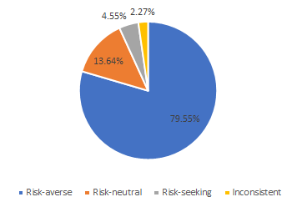
Risk categorisation

Slide 6
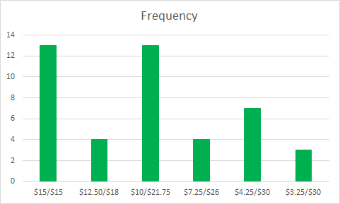
Choices in the Eckel and Grossman task

Slide 7
Relative risk aversion using the Eckel and Grossman method
Lottery | $15/$15 | $12.50/$18 | $10/$21.75 | $7.25/$26 | $4.25/$30 | $3.25/$30
Range of relative risk aversion coefficient | r > 1 | 0.71 < r ≤ 1 | 0.42 < r ≤ 0.71 | 0.18 < r ≤ 0.42 | -0.14 < r ≤ 0.18 | r ≤ -0.14
Proportion of subjects | 29.55% | 9.09% | 29.55% | 9.09% | 15.91% | 6.82%
Proportion of subjects in Deck et al. (2010) | 19.80% | 16.34% | 25.74% | 9.90% | 17.33% | 11.39%

Slide 8
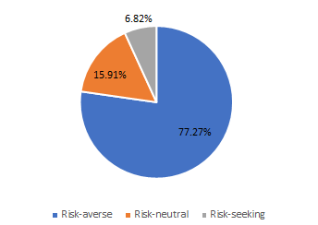
Risk categorisation

Slide 9
Gender differences
Experimental group | Median | Mean
Female (HL) | 0.545 | 0.47
Male (HL) | 0.545 | 0.47
Female (EG) | 0.565 | 0.606
Male (EG) | 0.565 | 0.478

Slide 10
Non parametric test
(Mann - Whitney U Test)
Experiment | p-value
Holt- Laury | 0.433
Eckel- Grossman | 0.178
Null Hypothesis (H0): Medians of each group are equal
Alternate Hypothesis(H1): Median values for each group are not equal
We can observe that p-value > .05 in both experiments. Hence we don’t reject null hypothesis, i.e medians of each group(gender) are equal

Slide 11
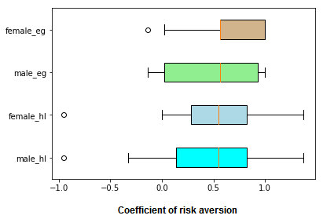
Gender differences

Slide 12
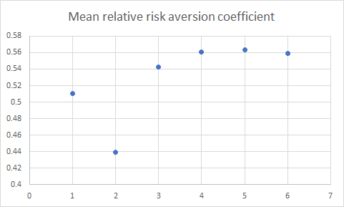
Comparison of the two methods
1: Holt and Laury - full sample
2: Holt and Laury - experimental class
3: Holt and Laury - non-experimental students
4: Excel and Grossman - full sample
5: Eckel and Grossman - experimental class
6: Eckel and Grossman - non-experimental students

Slide 13
Within-subject consistency
Two subjects displayed risk-averse preferences in one task and risk-seeking preferences in the other
Further 8 subjects recorded as risk-neutral on one task and either risk-seeking to risk-loving on the other
Our results are consistent with previous literature showing that risk preferences are not stable across risk elicitation methods
Anderson and Mellor (2008) find risk preferences are not stable across the Holt-Laury method and a survey-based measure with hypothetical gambles related to income and inheritance
Dave et al. (2007) find that subjects exhibit greater risk aversion in the Holt and Laury task compared to the Eckel and Grossman task

Slide 14
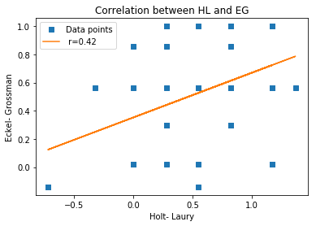
Correlation between experiments

Slide 15
Why do preferences change within subjects?
Risk is domain-specific
Deck et al. (2008) show risk attitude toward investment decisions influences behaviour in the HL task but not the Deal or no Deal task, but the Deal or no Deal task is associated with attitudes towards gambling, whereas, HL is not.
Differences in the number of categories and the number of choices
Focal point

Slide 16
What have we learned?
In line with previous findings, students in our class are mostly moderately risk-averse
We don’t find strong evidence for differences between males and females, which are common in studies looking at gender (especially for the Eckels and Grossman task)
Some subjects display different risk preferences according to the risk elicitation method employed

Slide 17
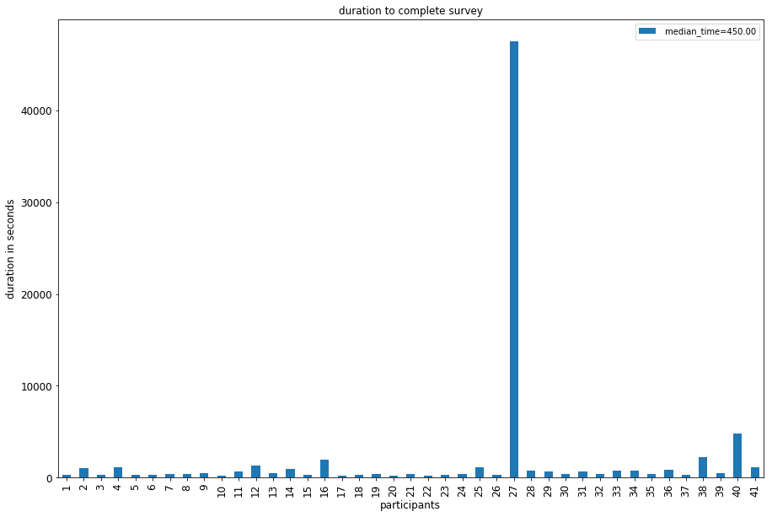
Duration for completing experiment

Slide 18
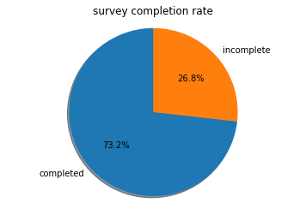
Attrition rate

Slide 19
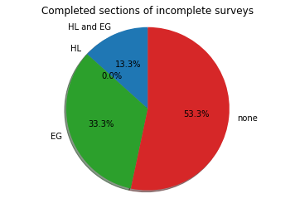
How incomplete surveys looked

